Slide 1
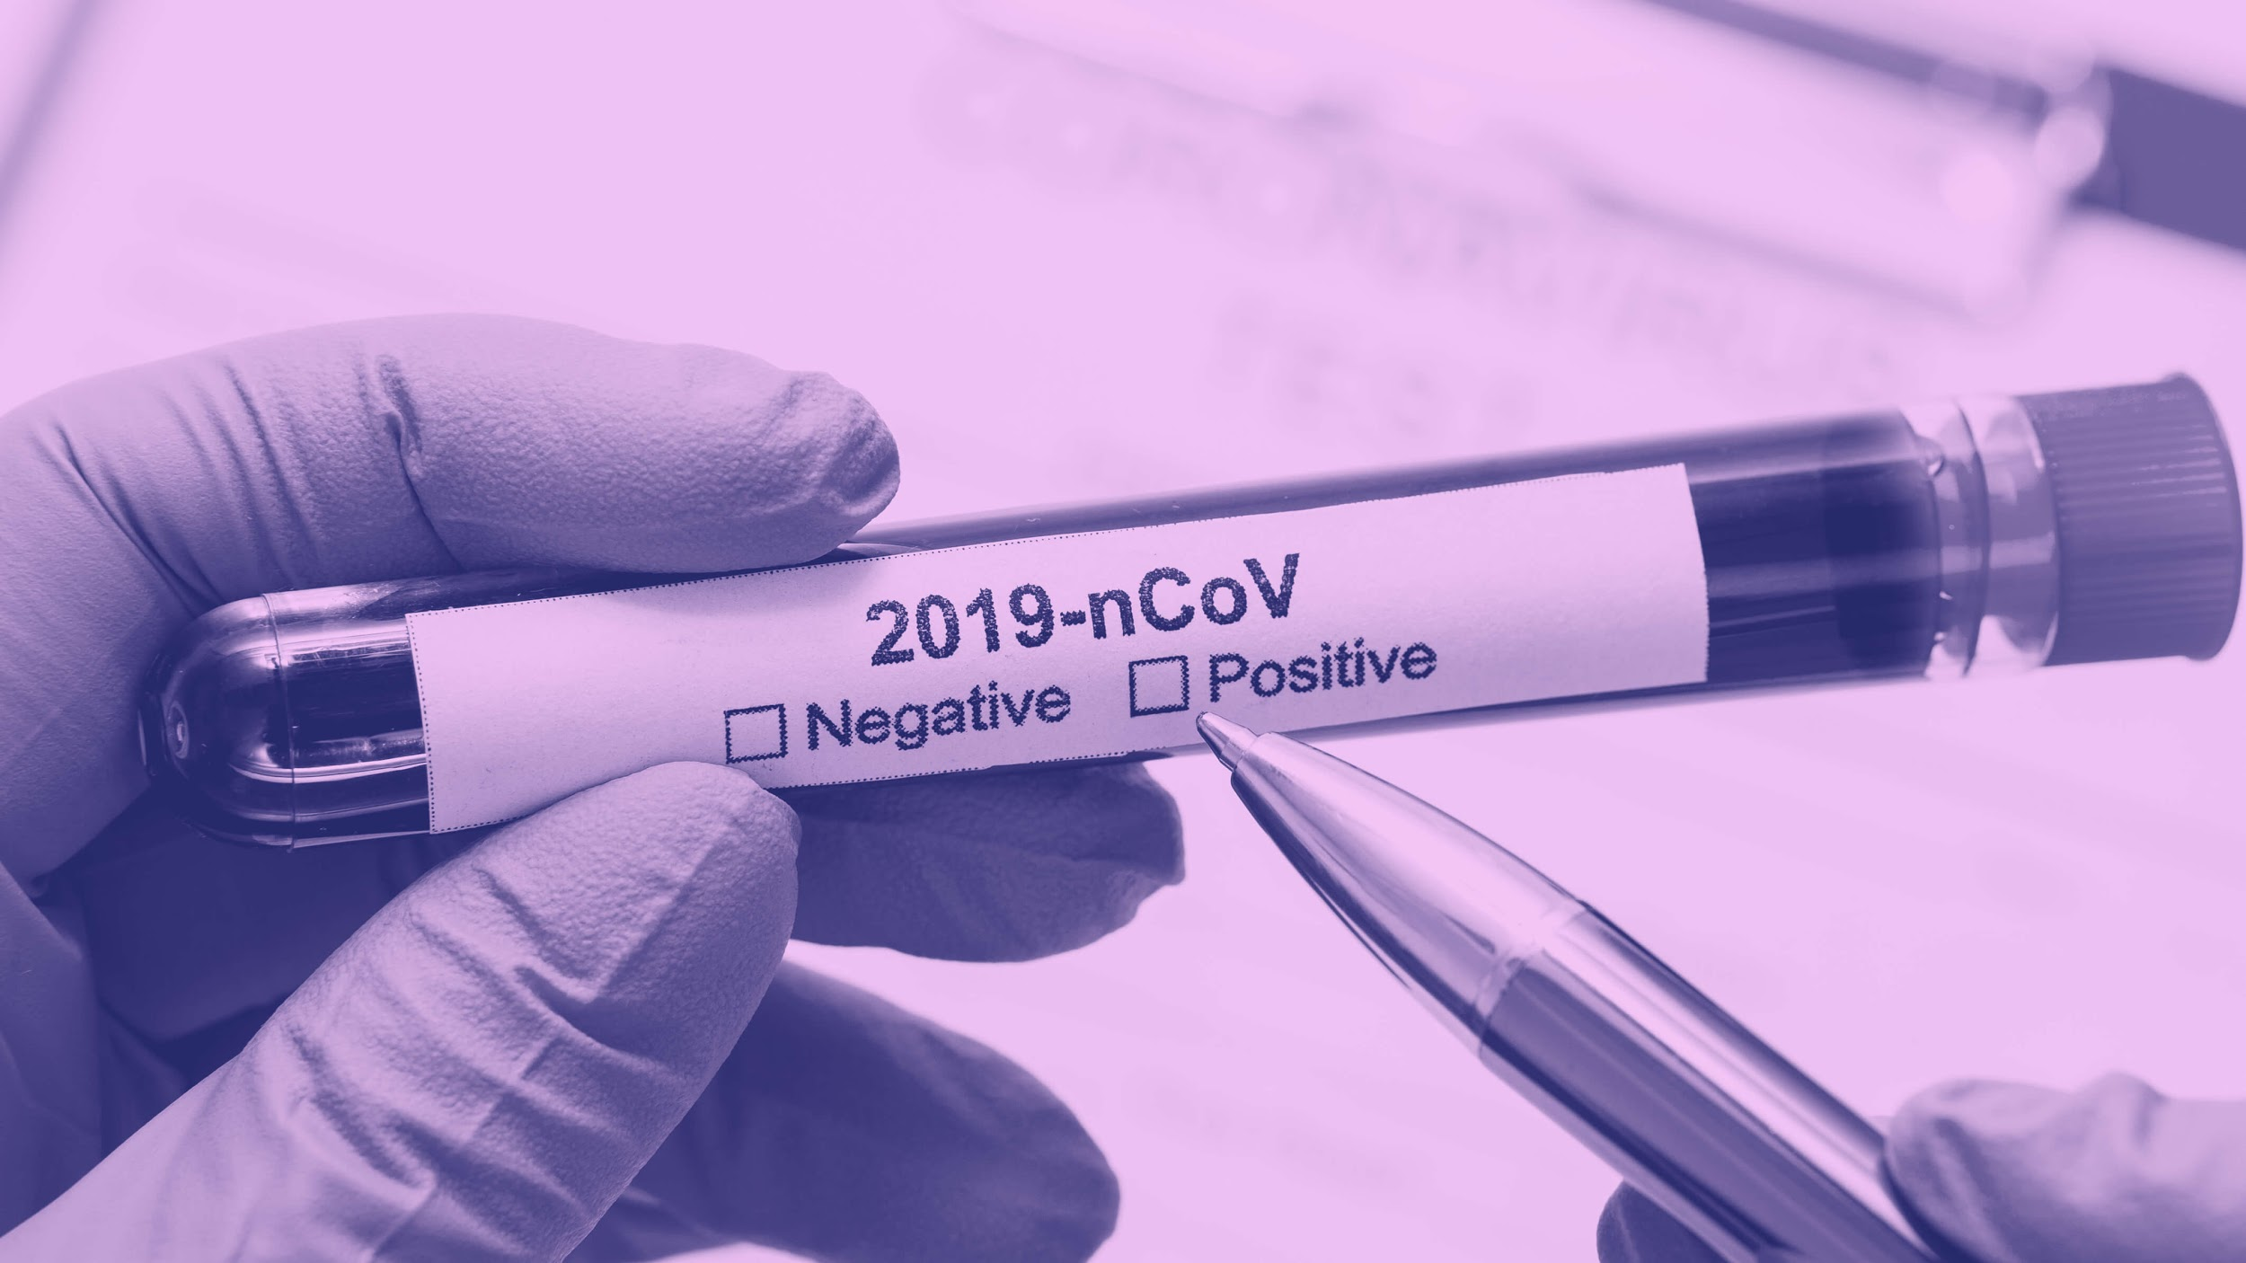
Flatten the Curve as a Whole r/COMMUNITY
- NLP Analysis of Reddit Comments Content
BY: Talk COVID to Grandma
Notes:
Hello Everyone! We are Team “Talk Covid to Grandma”. We were reached out by Reddit, one of the most-used websites in the US, to offer strategies to encourage its community to flatten the curve and show its corporate social responsibility. Today, we would like to present our study to the Reddit Management Team.

Slide 2
AGENDA
01
Introduction
02
Method
03
Model Results
04
Recommendations

Slide 3
COVID-19 TIMELINE
Jan 11, 2020
China reports first fatal case
Jan 30, 2020
WHO declares global health emergency
Mar 16, 2020
Shelter in place starts in the San Francisco Bay Area
Jan 20, 2020
First confirmed case in the US
Notes:
(Background) After the first confirmed case of novel coronavirus (2019-nCoV) in the United States on Jan.20, the country has been in the acceleration phase of the pandemic till now. Although different parts of the country are seeing different levels of COVID-19 activity, as of April 6, 42 states, D.C., and Puerto Rico have issued shelter-in-place or stay-at-home orders. Living in the San Francisco Bay Area, which is the first US county to issue “shelter-in-place” order, we, about 6 millions residents, have been home for almost a whole month. (Question) As more and more people have been instructed to stay at home, our website, as the online discussion platform, is where all the heated discussions happen. Our team would like to see how people are reacting to the pandemic on Reddit.

Slide 4
BUSINESS OBJECTIVES
Flatten the Curve
Promote User Engagement
Social Responsibility
Improve Brand Image
Notes:
(Main objective/motivation) Based on analysis of various discussions on the pandemic, Reddit aims to see if they could guide topics so that they effectively help flatten the curve with the joint effort from its whole communities. Having this in mind, we decided to learn about the most concerned or heated topics discussed among people on Reddit regarding COVID-19. We want to identify how the topics are distributed and if these topics can actually help the society from various aspects to flatten the curve.
(potential impact) After our evaluation, we will provide recommendations to encourage users’ engagement, arouse more and more awareness of people regarding the prevention of COVID-19, and eventually flatten the curve while establishing the company’s image of social responsibility.

Slide 5
430M
1.7B
ABOUT REDDIT
Monthly Active Users
Comments
30%
199M
Growth in Userbase
Submissions / Posts
Source: Reddit's 2019 Year in Review
Notes:
(Data source) Here you can see a recap of how amazing Reddit is doing for 2019. Ranked the sixth most used website in the US, we have a user base that grew by 30% in 2019, amounting to 430 million. Moreover, we have 199 million posts and 1.7 billion comments added last year. Having these many active users as well as the rich database, we decided to develop topics model using Reddit submissions as our data source.
and another 30% of Year-over-year increase of monthly active users,

Slide 6
OUR METHOD
02
1. API
2. Database
3. NLTK
4. LDA
Scraped COVID related submissions from 3/1 - 4/11
Created a database containing 560K submissions
Performed data processing and word stemming
Set optimal model with high coherence score; clustered text into topics
Notes:
(Data Integrity) Determining our data source, we start to build our dataset. We scraped all the Reddit submissions from 3/1 to 4/11 with a query of “COVID” in it. Requesting and pulling 1000 submissions from the Reddit API at a time, we created a database containing 560 thousands submissions in total.
(Use of ML) We then applied Natural Language Toolkit to tokenize and stem the words. And finally used a Latent Dirichlet Allocation (aka LDA) model to find our most distinguishable topics.We tried imaginary topics number from 10 to 20 and set 20 as the final topic number because it gives higher and stable coherence score. And we assume that the output of the model can have a fairly evenly distribution of the topics. (131)

Slide 7
STAGE 1 - MODEL RESULTS
Topic Distribution
Communities
Across all communities
Rank of communities where COVID-19 is mostly discussed
80% Case Related
Notes:
However, the output of the first model does not ideally align with our assumption. Even though we set 20 topics/clusters for our model, 80% of the data fall into one cluster. We evaluated some most representative submissions from the rest 20%, and found that they are actually out-of-scope topics, like fraud information, politics conspiracy, other natural disasters, and etc.
(underlying assumptions) Therefore, we want to narrow our dataset from all communities down to a specific community where COVID-19 is compactly discussed. We assumed that in a highly-active community regarding the same topics, people will have more diversified interests or perspectives toward a common question. So we found “Coronavirus” community as our narrow-down datasource. (100)

Slide 8
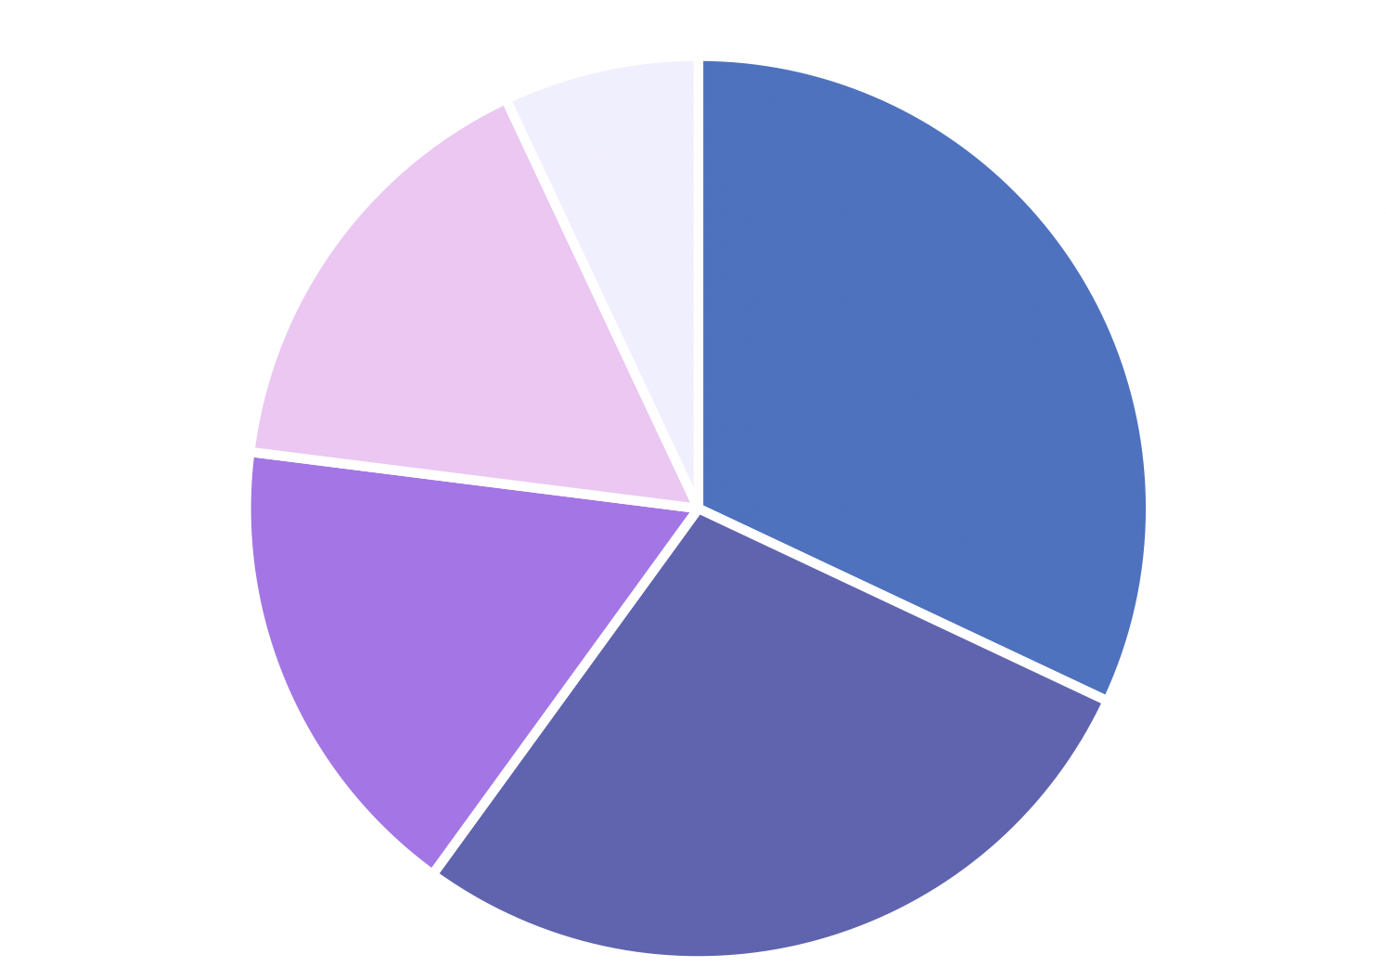
STAGE 2 - MODEL RESULTS
1
Treatment Prevention
Symptoms & Transmission Routes
COVID-19’s Impact
home, research, social, live, employee, infections, distancing
7%
COVID-19 Reaction / Policy
16%
32%
stay, quarantine, public, vaccine, help, risk, isolation
17%
patients, positive, test, live, treatment, medical, care
28%
Case Reports
cases, deaths, total, confirmed, positive, day, time
Notes:
(model result) After running our LDA model on the submissions retrieved from the Coronavirus community, we successfully divided these posts to 5 major topics and found that Covid-related topics identified on Reddit resonated well with the public’s concerns. The intimidating increasing number of cases brings about a great amount of relevant news and policy responses. Also the public is concerned about the societal impact as Covid-19 spread and effective measures to control the virus. People wanted to learn about Covid-19 transmission routes and the risks associated with Covid-19 infections.
(finding the problem) However, 60% of them are discussing news and policy (COVID-19 reaction (policy), case reports, symptoms and transmission routes), while only a small amount of them are talking about effective measures to control the virus and societal impacts. This indicates that people are passively receiving covid-19 related information rather than spontaneously having the awareness and intuition of precaution.
(transition) Only when people actively join the discussion about prevention, can they raise their awareness of prevention, then eventually unite as a whole community to fight against this invisible enemy, thus helping flatten the curve. (150)

Slide 9
RECOMMENDATIONS
Within Community
Do
Community Wide
Increase the number of prevention discussions through intervention of moderators
Create “Prevention” and “Mutual Help” post type
Maintain discussion quality
Encourage moderators to post and pin COVID prevention topics
Automatically subscribe new users to COIVD-related communities
Put more prevention related topics on ”Trending Today” or “Popular"
Notes:
(actionable insights) As a most visited discussion website, Reddit has the duty to raise the public awareness of prevention. In order to achieve this goal, we suggest the Reddit management team taking actions from two perspectives: within Coronavirus community actions and community-wide actions.
(KPI1 & recommendations) From the within-community perspective, we aim to increase the percentage of topics on prevention and impacts in the Coronavirus community. 1) Reddit should increase the number and exposure of prevention discussions through intervention of moderators, such as changing the suggested comment sort method by putting prevention comments at the top, or pinning effective prevention methods in the community, which makes the topic at the top of the page. 2) In addition, Reddit could create some more post type (flair), such as “prevention” and “mutual help”, and encourage discussions within these types. As of now, the hottest types (flair) are only regions and news. In “precaution” flair, topics on the effective and potential ways to prevent the virus should be posted. In “mutual help” flair, small business owners could share their experience to support each other, and professionals could give suggestions to graduates during this hard job-hunting period. 3) As the number of COVID-19 discussions increases, we also recommend Reddit to detect fake and fraud information to maintain discussion quality.
(KPI2 & recommendations) From the community-wide perspective, we aim to increase the number of users that join the discussion of covid prevention topics. 1) Encourage more moderators from various communities to post and pin covid-related prevention topics in their communities 2) For new users, Reddit could automatically subscribe them to covid-related communities 3) Reddit could put more prevention-related topics on trending today or Popular posts. (272)

Slide 10
Thank You!
Team: Talk Covid to Grandma
Notes:
(impact) We believe by adopting these recommendations, Reddit could establish its image of social responsibility. What’s more, we could raise the public’s awareness of prevention, thus reducing the spread speed and infectious cases for the whole society.

Slide 11
REFERENCES
Fernandez, M. (Apr. 2020), More states issue stay-at-home orders as coronavirus crisis escalates. Retrieved from https://www.axios.com/states-shelter-in-place-coronavirus-66e9987a-a674-42bc-8d3f-070a1c0ee1a9.html
Reddit's 2019 Year in Review
https://redditblog.com/2019/12/04/reddits-2019-year-in-review/

Slide 12
APPENDIX A: MACHINE LEARNING METHODS
ML comparison for topics modeling | Pros | Cons
Latent Semantic Analysis (LSA) | Quick and efficient to use | 1. Lack of interpretable topics and embeddings 2. Need large set of documents and vocabulary to get accurate results 3. Less efficient representation
Probabilistic Latent Semantic Analysis (pLSA) | Adds a probabilistic treatment of topics and words on top of LSA, therefore more accurate | 1. Don’t know how to assign probabilities to new documents 2. The number of parameters for pLSA grows linearly with the number of documents, which might lead to overfitting
LDA | 1. Could get human-interpretable topics from a document corpus 2. More representative 3. Works better than pLSA on unseen data | 1. May consume more time 3. Less efficient for very complex NLP
https://medium.com/nanonets/topic-modeling-with-lsa-psla-lda-and-lda2vec-555ff65b0b05

Slide 13
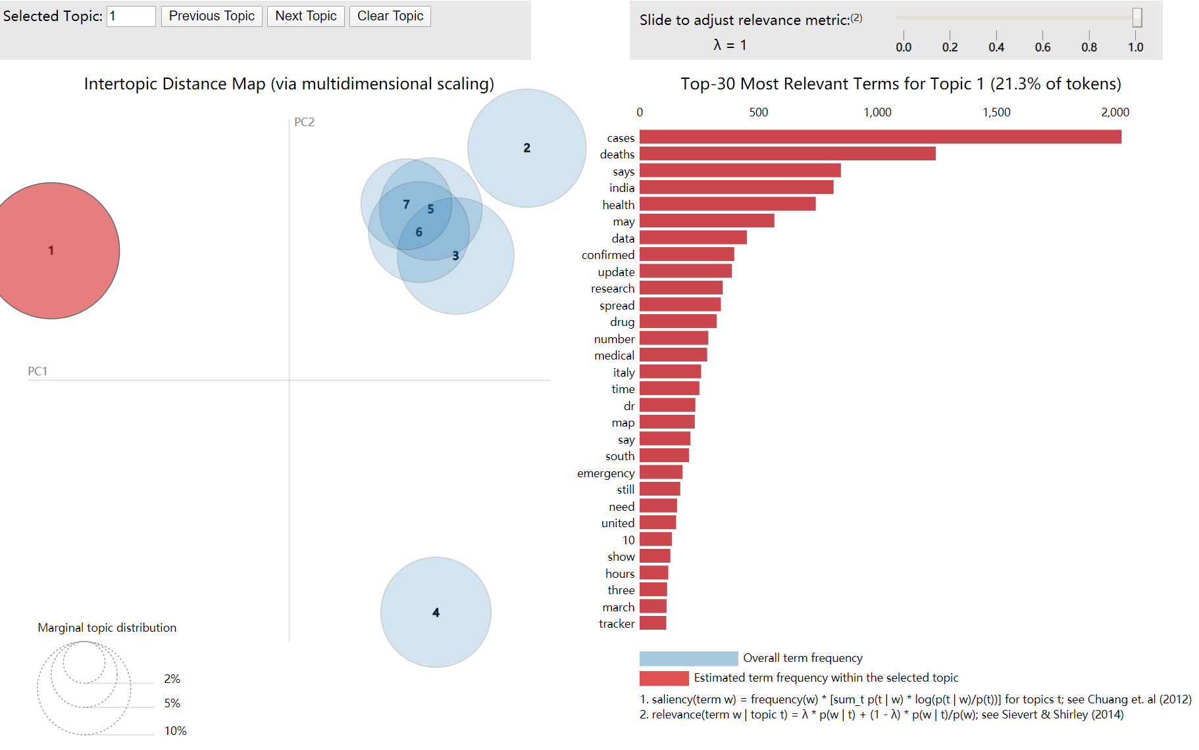
APPENDIX B: INTERACTIVE GRAPH
Source: https://freiheit77.github.io/COVID-19-Topics-Model/covid_sub_vis.html

Slide 14
APPENDIX C: REPRESENTATIVE COMMENTS
Topics | Percent (%) | Keywords | Representative sentences
COVID-19 reaction (policy) | 32.1% | stay,quarantine,public,vaccine,help,risk,isolation | “Government of Paraguay ordered closing of all schools, and all public and private gatherings, including cinemas, casinos and bars.”
Case reports | 28.1% | cases,deaths,total,confirmed,positive,day,time | “United States exponential #COVID-19 case growth is still tracking Italy. The US is still on track for 10,000 #COVID19”.
Treatment and prevention | 16.9% | patients,positive,test,live,treatment,medical,care | “High dose IV Vitamin C improves symptoms and eliminated mortality in a study of 50 patients with moderate to severe Covid” “Italian medical system is collapsing under COVID-19, disaster mode for medical facilities”.
COVID-19’s impact | 16.1% | home,research,social,live,employee,infections,distancing | “COVID-19 Outbreak: Google Cancels It's Biggest Event of The Year And Advise It's North American Workers To Work From Home”.
Symptoms and transmission routes | 6.8% | symptoms,researchers, pandemic,infected,vaccine,doctor, china | “Compared side-by-side to the flu, the only major difference is that COVID-19 appears to have a lower mortality rate among children”. “Relationship between the ABO Blood Group and the COVID-19 Susceptibility”.

